Slide 1
eeef - European Energy Efficiency Fund Workstream: enhanced operational cooperation between EIB and NPBs Luxembourg, 26 March 2015

Slide 2
eeef at a glance
Objective
eeef is an innovative public-private partnership dedicated to mitigating climate change through market based financing in the member states of the European Union
Beneficiaries
Municipal, local and regional authorities or public and private entities acting on behalf of those authorities such as utilities, public transportation providers, social housing associations, ESCOs etc.
eeef’s capital
Initial capitalization of the fund amounting to €265m provided by the European Commission, the European Investment Bank, Cassa Depositi e Prestiti and Deutsche Bank
Investments
Fund’s investments are split into three project categories:
Energy Efficiency (EE)
Renewable Energy (RE)
Clean Urban Transport

Slide 3
eeef fund structure
EUR, Local FX investments
EUR funding
Technical Assistance Facility
Investment Committee
Issuer Vehicle
Luxembourg
Investors
Management Board
Municipal, local, regional and national authorities and public or private entities acting on behalf of those public authorities
Investment Advisor
Super-Senior Tranche
(Notes)
Institutional Investors
Direct Debt & Equity
Senior Tranche
(A Shares)
Private Investors, International Financial Institutions or Development Finance Institutions
Mezzanine Tranche
(B Shares)
Private Investors, International Financial
Institutions or Development Finance Institutions
FIs
Loans
Senior & Sub Debt Loans
Junior Tranche
(C Shares)

Slide 4
Decision making process and organisational responsibilities
Supervisory Board
Management Board (MB):
Responsible for the overall management of EEEF and make key oversight decisions
Nominated by the shareholders, approved by CSSF
Min 3 persons, max 5 persons (1 seat for EC, 1 seat for EIB, 1 seat for CdP)
Investment Committee (IC):
Engaged in the oversight of fund management through its participation in the investment decision making process
Nominated by the MB
Min 3 persons, max 5 persons
Supervisory Board:
Permanent supervision of the management of the Fund
Nominated by the shareholders
Min 3 persons, max 6 persons (2 seats for EC, 1 seat for EIB, 1 seat for CdP)
Investment Manager:
Responsible for the management of the Fund’s assets in accordance with the Investment Guidelines
Supervision of the Fund activities and strategic advice
Management Board
3
Investment recommendation
4
Investment proposal after discussion with IC and credit discussion with MB
Investment Committee
Investment Manager
2
Investment proposal and credit discussion
Financing commitment
5
1
Financing request
Project

Slide 5
Advantages of the eeef from a borrower's perspective
Fast and flexible financing
Professional investment advisor, decision making process from initial screening (assuming all information is provided) until financial close no longer than 6 months
One-stop shop from project development support via grants from the TA facility to tailor-made financing of projects
Various financing instruments
The fund offers various financing instruments including senior debt, mezzanine, equity, leasing structures and forfeiting loans
Fund can also operate as the sole investor in projects (single investor transactions) to simplify implementation and lower execution costs
Long maturities
Flexible with respect to maturities:
Debt can be provided for maturities up to 15 - 20 years
Equity or mezzanine capital can be provided to act as co-sponsor or long-term subordinated risk taker

Slide 6
eeef Technical Assistance facility and possible co-operation with Structural Funds
Technical Assistance
by EC
eeef’s intital TA facility of €20m supports its beneficiaries (municipalities) in developing their projects by providing European Commission grants for up to 90% of the total costs and subject to later financing by eeef
The application phase for this TA facility expired March 2014
Technical Assistance
by eeef
The shareholders of the Fund can decide each year to use part of the financial returns generated to fund the eeef TA facility to support municipalities to develop energy efficiency projects
Financing of projects
together with
Structural Funds
Due to requirements by the EC a direct co-financing of one project by Structural Funds and the eeef is not allowed
If the project can be separatd into different phases, with Structural Funds and eeef financing possible for different phases

Slide 7
Back-up slides
1
eeef – typical ESCO structures
2
TA overview
3
Portfolio overview and selected case studies

Slide 8
Typical ESCO structures:
A classic project finance structure
ESCO Partner
Municipality
eeef offers a long term financing
eeef is not detered by smaller projects
Construction phase is embraced in the financing
Standard project finance package
More flexible in execution than commercial banks
Commercial rate funding
ESCOs profit from off balance sheet structure
Junior funds
(15%-30%)
Capital injection
Repayments
SPV
(ESCO founded)
Construction and O&M
contracts
Senior debt
Sub-contracts (a)
eeef
EPC partner
O&M partner/s
Sub-contracts (b)

Slide 9
Typical ESCO structures:
Purchase of receivables
1
ESCO Partner
Installations/construction, O&M, energy savings guarantee
eeef offers non recourse solution to be implemented
quickly
Purchase of receivables does not include future receivables for services (O&M is not sold)
ESCO is responsible for energy savings performance during the tenor of the financing contract, re- payment obligations when savings are not realised
City is co-operating with the financing partner known to it from the Technical Assistance cooperation
Assigning of
receivables (80%-90%
of the funding amount)
discounted (discount
factor to be outlined)
2
Municipality
eeef
3
Payments based on the savings share, no increase of the City budget

Slide 10
eeef Technical Assistance overview
Public authority |  | Country | Description of the investment programme | Total size of the investment programme (€ m) | TA volume provided (€) | Estimation of CO2 reduction (tons per annum)
 | City of Santander | Spain | EE – Public lighting/ building retrofit | 9.1 | 452,560 | 2,464
 | City of Cordoba | Spain | EE – Public lighting/ building retrofit | 18 | 754,240 | 6,824
 | Cabildo of La Palma | Spain | Public lighting/ building retrofit/clean urban transport | 30.1 | 871,941 | 4,347
 | City of Terrassa | Spain | Public lighting/ building retrofit/clean urban transport/ PV | 18.5 | 623,467 | 9,113
 | City of Marbella | Spain | Public lighting/ building retrofit/ PV | 12.5 | 456,662 | 5,459
 | Région Rhone Alpes | France | EE – Buildings upgrade | 5 | 1,125,000 | *
 | Municipality of Ringkøbing-Skjern | Denmark | RE – Biomass | 173.3 | 1,917,500 | 21,600
 | Ore Valley Housing Association | UK | EE – Decentralised district heating | 35 | 1,728,150 | 22,400
 | City of Elche | Spain | Public lighting/ building retrofit/clean urban transport/ PV/Biomass | 20.2 | 782,367 | 8,983

Slide 11
eeef Technical Assistance overview (continued)
Public authority |  | Country | Description of the investment programme | Total size of the investment programme (€ m) | TA volume provided (€) | Estimation of CO2 reduction (tons per annum)
 | City of Venlo | Netherlands | EE - Public lighting | 8.5 | 425,000 | 2,291**
 | University of Liège | Belgium | EE – Buildings upgrade | 30 | 1,500,000 | 3,200
 | Limerick and Clare Education and Training Board | Ireland | EE – Buildings upgrade RE – PV/micro wind | 16.4 | 335.835 | 2,850
 | Groupement de Redéploiement Economique de la province de Liège | Belgium | EE – Buildings upgrade | 43.5 | 2.000.000 | 6.030
 | CIMAC (Comunidade Intermunicipal do Alentejo Central) | Portugal | Public lighting/ building retrofit/clean urban transport/ PV and biomass | 12.0 | 540,000 | 6,500
 | City of Zaanstad | Netherlands | EE- District heating network | 10.0 | 463,860 | 4,500
Total: |  |  |  | € 442.1m | € 14.0m | 106,561
* To be determined
** Forecast, based on current savings for 2013

Slide 12
eeef portfolio overview as of today
Investments by Projects (in %)
Investments by Country (in %)
Investments by type of Partner Institution (in %)
Investments by Financial Instrument (in %)

Slide 13
Energy efficiency upgrade of the University
Hospital S. Orsola Malpighi - Bologna, Italy
Project description
Partners: | Progetto ISOM S.p.A (project SPV) University Hospital S. Orsola Malpighi (grantor of concession)
Measures: energy efficiency CCHP | Upgrade of entire fluids’ production and distribution system of the hospital Including a tri-generation plant for the combined production of cooling, heat and power (CCHP)
Results: | Reduction of CO2 emissions of 14,136 t p.a., approx. 31% compared to baseline
Location
Bologna, Italy
Project structure
Investment characteristics
Key data: Total project volume: €41 m (equity provided by Manutencoop Facility Management, Siram, Sinloc and Iter Cooperativa Ravennate) EEEF funded volume: €32m via a project bond structure Duration of financing: 20 years Highlights: Largest energy efficiency upgrade in Italy under a Public Private Partnership (PPP) framework Lighthouse project for the Italian and European energy efficiency market demonstrating the positive impact of a major energy efficiency investment in a complex hospital; replication potential
−
Manutencoop
Facility
Management
−
Siram
−
Sinloc
Equity funding
Project bond + VAT bond
SPV Progetto ISOM S.p.A.
EPC and O&M
EPC & O&M consortium
Concession agreement
UHSOM
(Grantor of
concession)
Regional funding
−
Region
of healthcare
Emilia
Romania

Slide 14
Combined Heat and Power Plant (biomass) –
City of Orléans, France
Project description
Partners: | City of Orléans, Dalkia France, eeef
Measures: Biomass plant/ energy efficiency | Dalkia won a public tender realized under a French Regulation Commission Tender („CRE3“) for electricity /heat generation fired by biomass Biomass-fired combined heat and power plant with a capacity of 7.5 MW in electricity and 17 MW thermal energy
Results: | Reduction of CO2 emissions of 20,500t p.a., approx. 89.1% compared to baseline Energy production 50,826 kWh p.a.
Location
Orléans, France
Project structure
Investment characteristics
Key data: EEEF is a 84.4% shareholder of Orléans Biomasse Energie s.a.s Total project volume: €36 m Total debt financing volume: €30m Duration of financing: 18 years Highlights: Decentralized energy supply for City of Orléans using existing district network Supply of biomass within 100 km Long term PPA agreement with EDF
Land rights
agreement
Contract for
electricity sale
Orléans Biomasse Energie s.a.s
EDF
City of Orléans
Construction
contract
Operation and
maintenance ,
Incl. biomass supply
Public concession for Heat supply to district heating network
Dalkia Biomasse Orléans s.a.s

Slide 15
Building retrofit of the University of Applied
Sciences - Munich, Germany
Project description
Partners: | University of Applied Sciences Munich (UoM), Johnson Controls, eeef
Measures: Building upgrade/ energy efficiency | Installations of combined heat and power plant Installation of energy efficient lighting Optimization of heating Optimization of building management
Results: | Reduction of CO2 emissions 88t p.a. approx. 11.6% compared to baseline Guaranteed energy savings € 118,860 p.a. (41.7%)
Location
Munich, Germany
Financing structure
Investment characteristics
Key data: Financing volume: approx. €0.6 m Duration of financing: 10 years Highlights: Second project with the innovative forfeiting structure EE measure including a CHP plant (decentralized energy production) Role model for further energy efficiency investments in schools, universities etc.
(Purchaser)
Pays receivables/ energy savings
3
2
Forfaiting agreement:
purchase of
70% of receivables /
energy savings
ESCO (Seller)
UoM
(Employer)
1
Implementation of EE measures acc. to energy performance contract (EPC)
Savings guarantee

Slide 16
Green lending cooperation with Banca Transilvania-
Cluj-Napoca, Romania
Project description
Partners: | Banca Transilvania S.A. (‘BT’)
Measures: | EEEF and BT, one of the leading banks in Romania signed a letter of intent regarding green lending to support energy efficiency and renewable energy investments Provision of financing to public and private building owners, homeowner associations and municipalities, public sector entities and private sector companies acting on behalf of the public sector
Results: | Average CO2 emission reduction of at least 20% for projects financed via BT
Location
Cluj-Napoca, Romania
Financing structure
Investment characteristics
Key data: Financing volume: approx. €25 m Duration of financing: 10 years Highlights: First cooperation of the EEEF with a financial institution and also EEEF’s first project in Eastern Europe Strong local partner with credentials in financing several energy efficiency projects Role model for further Financial Institutions investments
(Lender)
Loan Agreement
Sub-loans for EE and RE projects
(Borrower)
(Sub-borrowers)

Slide 17
Street lighting upgrade of the City of Venlo–
Venlo, Netherlands
Project description
Partners: | City of Venlo (Borrower)
Measures: Energy efficiency Street lighting | The City of Venlo upgrades of the existing street lighting network of the city with energy efficient LED lamps The existing O&M contract for the street lighting network with a private service company stays in place and includes the upgraded lighting points
Results: | Achievement of primary energy savings of around 62% p.a. compared to baseline
Location
Venlo, Netherlands
Project structure
Investment characteristics
Key data: Total project volume: €8.5m eeef funded volume: €8.5m via a senior debt loan covered by the City of Venlo Duration of financing: 15 years Highlights: First direct lending to a municipality by eeef. The street lighting upgrade is part of an overall green development plan of the city Reference project for European public authorities demonstrating efficient financing solutions for energy efficiency and renewable energy projects via eeef
(Lender)
(Borrower)
Loan Agreement
Obligation to invest into energy efficiency projects

Slide 18
Car-sharing programme for electric cars-
Cities of Paris, Lyon and Bordeaux, France
Project description
Partner: | Bolloré S.A.
Measures: Public urban transpor-tation | Bolloré SA won the concession for the first large scale electric vehicle renting scheme in the greater Paris region (Ile-de-France) expansion of Bolloré’s core infrastructure (e.g. cars, charging stations, rental kiosks)
Results: | Reduction of CO2 emissions of min. 50% compared to baseline
Location
Paris, Lyon and Bordeaux, France
Project structure
Investment characteristics
Key data: Bond issue (private placement): €30m Duration of financing: 5 years Repayment: Bullet structure Highlights: First eeef transaction for clean urban transport in Europe 51 municipalities in the Paris/ Île-de-France region participating, accessible to more than 4 out of 7 million inhabitants First clean urban transport project for the fund
Paris
Bordeaux
Lyon
Obligation to expand core infrastructure
Bond purchase
100%
12 year concession for the Paris/ Île-de-France region; Lyon and Bordeaux to come

Slide 19
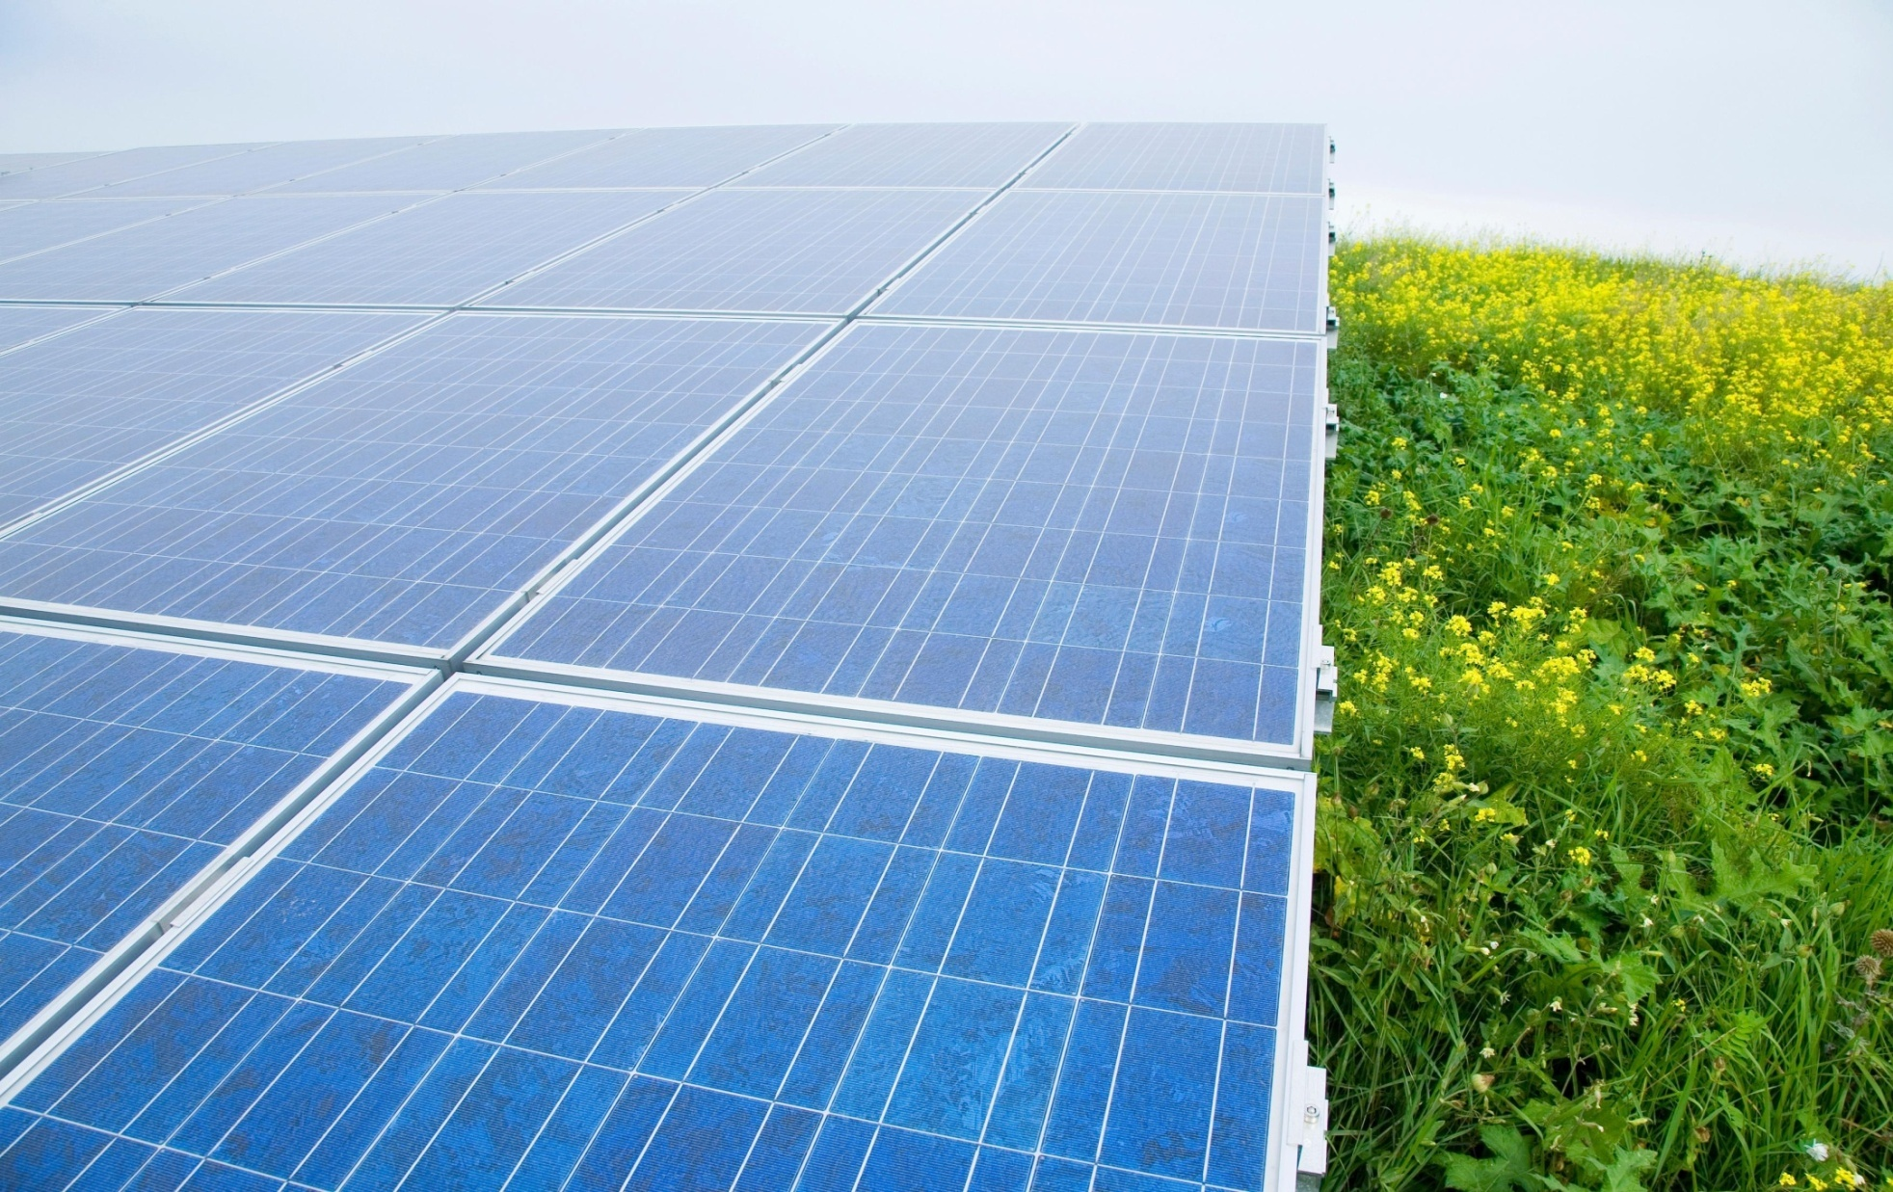
Contacts
European Energy Efficiency Fund (eeef)
Lada Strelnikova
+49(69)910-46444
lada.strelnikova@db.com
Zarpana Signor
+49(69)910-49858
zarpana.signor@db.com
Matthias Benz
+49(69)910-46449
matthias.benz@db.com
Pablo Cavia
+44(20) 754-15328 69
pablo.cavia@db.com
www.eeef.eu

Slide 20
© Copyright 2015. European Energy Efficiency Fund, SICAV-SIF, 31 Z.A. Bourmicht, L-8070 Bertrange, Luxembourg. All rights reserved.
This presentation (the ‘Document’) has been prepared by European Energy Efficiency Fund, SICAV-SIF (‘European Energy Efficiency Fund‘) exclusively for the benefit and internal use of the potential client (‘Client’) in order to indicate, on a preliminary basis, the feasibility of a possible transaction or transactions. The Document may only be used for these purposes. The Client is not permitted to duplicate the information provided in this Document and to communicate the received information of this Document to any third party without the prior written consent of European Energy Efficiency Fund.
The Document is incomplete without reference to, and should be viewed solely in conjunction with, the oral briefing provided by European Energy Efficiency Fund. The Document is neither intended to serve as legal or tax advice nor should it replace it.
The information in the Document reflects prevailing conditions and European Energy Efficiency Fund's views as of this date, all of which are subject to change.
Neither the European Energy Efficiency Fund nor their directors, officers, agents or employees, customers or professional advisers make any representation, warranty or undertaking, express or implied, as to the accuracy, reliability, completeness or reasonableness of the Document. The aforementioned persons will be under no duty to provide access to any additional information or to update or correct (if required) any Information. Accordingly, neither the European Energy Efficiency Fund nor the aforementioned persons will be liable for the accuracy, reliability, completeness or reasonableness of the Document.

